Slide 1


The Role of Maasai Culture in Highlighting the Importance of Gender Awareness in African Society
The Maasai people, a semi-nomadic ethnic group primarily found in Kenya and Tanzania, are known for their distinct cultural practices, colorful attire, and unique social structure. The Maasai culture, rich in traditions and rituals, provides an insightful lens through which we can explore the importance of gender awareness in African society.

Slide 2
Maasai Culture and Traditions
Social Structure and Roles
Rites of Passage
Attire and Jewelry
Traditionally, the Maasai society is patriarchal, with men holding dominant positions in decision-making, leadership, and warrior roles. Women, on the other hand, are primarily responsible for domestic duties, child-rearing, and gathering resources like water and firewood.
The Maasai culture places significant emphasis on rites of passage, which mark the transition from one stage of life to another. For boys, this includes ceremonies like circumcision and warrior initiation (moranhood), while for girls, it traditionally involves practices such as female circumcision (FGM) and marriage.
The Maasai are renowned for their vibrant attire and intricate beadwork. Both men and women wear colorful shukas (cloths) and adorn themselves with beaded jewelry, which signifies social status, age, and marital status.

Slide 3


Importance of Gender Awareness in Maasai Society
1
Challenging Harmful Practices
One of the most critical aspects of gender awareness in Maasai culture is addressing harmful traditional practices such as female genital mutilation (FGM) and early marriage. These practices have significant health, psychological, and social impacts on women and girls. Increased gender awareness and advocacy have led to a decline in FGM and the promotion of alternative rites of passage that do not involve physical harm.
2
Empowering Women through Education
Education is a powerful tool for promoting gender equality. Traditionally, Maasai girls have had limited access to education due to early marriage and domestic responsibilities. Gender awareness campaigns and community programs are now encouraging the education of girls, which not only empowers them but also benefits the community as a whole. Educated women are more likely to advocate for their rights, contribute economically, and make informed decisions about their health and family.
3
Promoting Women's Health
Gender awareness has brought attention to the specific health needs of Maasai women. Access to reproductive health services, maternal care, and information about family planning are crucial for improving women's health outcomes. Community health programs that focus on educating both men and women about these issues have shown positive results in reducing maternal mortality and improving overall health.

Slide 4

Economic Empowerment and Leadership
Economic Empowerment
Leadership and Participation
Traditionally, Maasai women have been involved in activities like beadwork and selling crafts, but their economic opportunities were limited. Gender awareness initiatives have helped expand these opportunities by providing women with skills training, access to microfinance, and support for entrepreneurial ventures. Economic empowerment not only improves the standard of living for women but also strengthens the entire community.
Increasing the participation of women in leadership roles within the Maasai community is another crucial aspect of gender awareness. Women's voices are essential in decision-making processes, and their involvement can lead to more inclusive and equitable policies. Programs that support women's leadership development and encourage their participation in community councils and local governance are making strides in this area.

Slide 5

Case Studies and Examples
1
Alternative Rites of Passage
Organizations such as the Maasai Girls Education Fund (MGEF) and Amref Health Africa have implemented programs to replace FGM with alternative rites of passage. These programs involve education on health and rights, and a ceremony that honors the girls' transition to womanhood without physical harm.
2
Education Initiatives
Schools like the Emusoi Centre in Tanzania provide education and support for Maasai girls, helping them to overcome barriers and pursue higher education. These initiatives have led to increased literacy rates and more women pursuing careers in various fields.
3
Economic Projects
Projects like the Olkonorei Integrated Pastoralist Survival Project (OIPSP) focus on improving economic opportunities for Maasai women through training in sustainable agriculture, livestock management, and small business development.

Slide 6

Conclusion
The Maasai culture, with its rich traditions and social structures, offers valuable insights into the importance of gender awareness in African society. By challenging harmful practices, promoting education, improving health outcomes, empowering women economically, and encouraging their participation in leadership, the Maasai community demonstrates how gender awareness can lead to positive changes and development. These efforts not only benefit women but also contribute to the overall well-being and progress of the entire community, highlighting the critical role of gender equality in African societies.

Slide 7
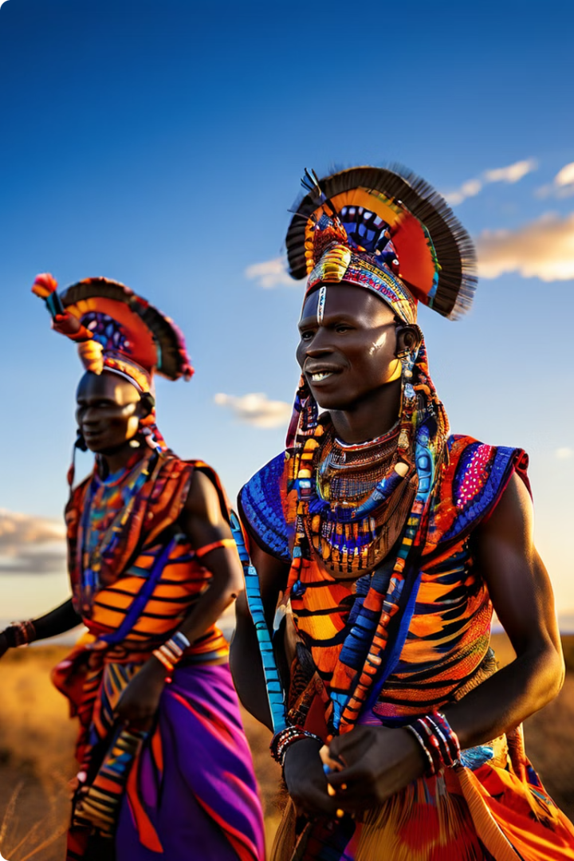



The Power of Maasai Traditions
Community Cohesion
Maasai traditions and rituals foster a strong sense of community and collective identity, which can be leveraged to promote gender awareness and equality.
Preserving Traditions
While addressing harmful practices, it is important to recognize and preserve the positive aspects of Maasai culture, which can serve as a foundation for sustainable change.
Adaptability
The Maasai culture has demonstrated the ability to adapt and evolve, which is crucial for incorporating gender awareness and empowerment initiatives.

Slide 8
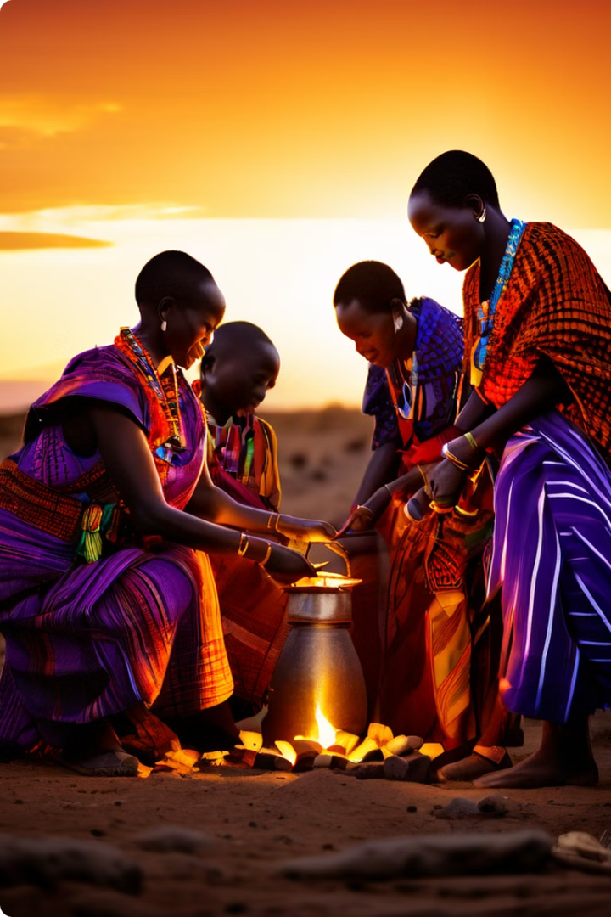



The Way Forward
Collaborative Approach
Addressing gender issues in Maasai society requires a collaborative approach that involves both men and women, traditional leaders, and community members.
Culturally Sensitive Initiatives
Gender awareness programs should be designed and implemented in a culturally sensitive manner, respecting the Maasai's rich traditions and incorporating their perspectives.
Sustainable Change
Lasting change in gender dynamics within the Maasai community can only be achieved through a long-term, holistic approach that addresses the root causes of inequality and empowers women in all aspects of their lives.

